Slide 1
Chapter 4
Writing a Business Plan
Bruce R. Barringer
R. Duane Ireland

Slide 2
Chapter Objectives
1 of 2
Explain the purpose of a business plan.
Discuss the two primary reasons for writing a business plan.
Describe who reads a business plan and what they’re looking for.
Explain the difference between a summary business plan, a full business plan, and an operational business plan.
Explain why the executive summary may be the most important section of a business plan.

Slide 3
Chapter Objectives
2 of 2
Describe a milestone and how milestones are used in business plans.
Explain why its important to include separate sections on a firm’s industry and its target market in a business plan.
Explain why the “Management Team and Company Structure” section of a business plan is particularly important.
Describe the purposes of a “sources and uses of funds” statement and an “assumptions sheet.”

Slide 4
Chapter Objectives
3 of 3
10. Detail the parts of an oral presentation of a business plan.
3-<number>

Slide 5
What Is a Business Plan?
Business Plan
  A business plan is a written document, typically 25 to 35 pages long, that describes what a new business plans to accomplish and how it intends to accomplish it.
Dual-Use Document
  For most new ventures, the business plan is a dual-purpose document used both inside and outside the firm.
4-<number>

Slide 6
Reasons for Writing a Business Plan
Internal Reason
External Reason
Forces the founding
team to systematically
think through every
aspect of their
new venture.
Communicates the
merits of a new venture
to outsiders, such as
investors and bankers.
4-<number>

Slide 7
Why Reads the Business Plan—And What Are They Looking For?
There are two primary audience for a firm’s business plan
Audience
What They are Looking For
A Firm’s Employees
A clearly written business plan helps the employees of a firm operate in sync and move forward in a consistent and purposeful manner.
Investors and other external stakeholders
A firm’s business plan must make the case that the firm is a good use of an investor’s funds or the attention of others.
4-<number>

Slide 8
Guidelines for Writing a Business Plan
1 of 4
Structure of the Business Plan
  To make the best impression a business plan should follow a conventional structure.
  Although some entrepreneurs want to demonstrate creativity, departing from the basic structure of the conventional business plan format is usually a mistake.
  Typically, investors are busy people and want a plan where they can easily find critical information.
4-<number>

Slide 9
Guidelines for Writing a Business Plan
Structure of the Business Plan (continued)
  Software Packages
    There are many software packages available that employ an interactive, menu-driven approach to assist in the writing of a business plan.
    Some of these programs are very helpful. However, entrepreneurs should avoid a boilerplate plan that looks as though it came from a “canned” source.
  Sense of Excitement
    Along with facts and figures, a business plan needs to project a sense of anticipation and excitement about the possibilities that surround a new venture.
4-<number>

Slide 10
Guidelines for Writing a Business Plan
2 of 4
Content of the Business Plan
  The business plan should give clear and concise information on all the important aspects of the proposed venture.
  It must be long enough to provide sufficient information yet short enough to maintain reader interest.
  For most plans, 25 to 35 pages are sufficient.
4-<number>

Slide 11
Guidelines for Writing a Business Plan
3 of 4
Style or Format of the Business Plan
  It should look sharp but not give the impression that a lot of money was spent to produce it.
  A plastic spiral binder including a transparent cover sheet and a back sheet to support the plan is a good choice.
  Avoid getting carried away with the design elements such as boldfaced type, italics, different font sizes and colors, clip art etc.
  There are three types of business plans, each of which has a different rule of thumb regarding length and level of detail.

Slide 12
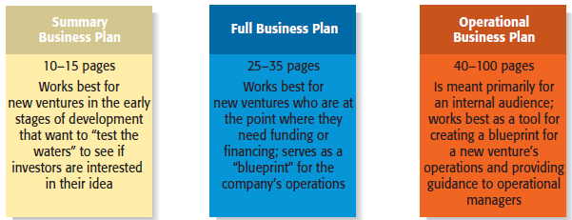
Types of Business Plans

Slide 13
Guidelines for Writing a Business Plan
4 of 4
Recognizing the Elements of the Plan May Change
  It’s important to recognize that the plan will usually change as it is being written.
  New insights invariably emerge when an entrepreneur or a team of entrepreneurs immerse themselves in writing the plan and start getting feedback from others.
  Entrepreneurs who have written business plans and have launched successful businesses stress that a business plan is a living, breathing document, rather than something that is set in stone.
4-<number>

Slide 14
Outline of the Business Plan
  A suggested outline of the full business plan appears in Table 4.2.
  Most business plans do not include all the elements introduced in the sample plan; we include them here for the purpose of completeness.
  Each entrepreneur must decide which elements to include in his or her plan.
4-<number>

Slide 15
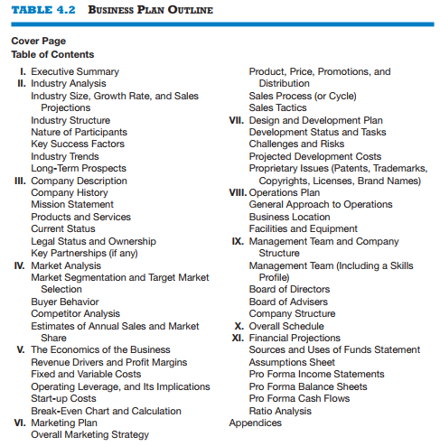
4-<number>

Slide 16
Cover Page and Table of Contents
  The cover page should include the company’s name, address, phone number, the date, the contact information for the lead entrepreneur, and the company’s Web site address if it has one. The company’s Facebook page and LinkedIn/Twitter name can also be included.
  The contact information should include a land-based phone number, an e-mail address, and a cell phone number.
  A table of contents should follow the cover letter. It should list the sections and page numbers of the business plan and the appendices.
4-<number>

Slide 17
Section 1: Executive Summary
1 of 2
Executive Summary
  The executive summary is a short overview of the entire business plan.
  It provides a busy reader with everything that needs to know about the new venture’s distinctive nature.
  An executive summary shouldn’t exceed two single-spaced pages.
  The cleanest format for an executive summary is to provide an overview of the business plan on a section-by-section basis. The topics should be presented in the same order as they are presented in the business plan.
4-<number>

Slide 18
Section 1: Executive Summary
2 of 2
Key Insights
In many instances an investor will
ask for a copy of a firm’s executive
summary and will ask for a copy of
the entire plan only if the executive
summary is sufficiently convincing.
The executive summary, then, is
arguably the most important
section of a business plan.
Executive Summary
4-<number>

Slide 19
Section 2: Company Description
1 of 2
Company Description
  This section begins with a general description of the company.
  Items to include in this section:
    Company description/ History.
    Mission statement.
    Tagline
    Products and services, Position.
    Current status; milestones
    Legal status and ownership.
    Key partnerships (if any).
4-<number>

Slide 20
Section 2: Company Description
2 of 2
Key Insights
While at first glance this section
may seem less important than the
others, it is extremely important.
It demonstrates to your reader that
you know how to translate an idea
into a business.
Company Description
4-<number>

Slide 21
Section 3: Industry Analysis
1 of 2
Industry Analysis
  This section should begin by describing the industry the business will enter in terms of its size, growth rate, and sales projections.
  Items to include in this section:
    Industry size, growth rate, and sales projections.
    Industry structure.
    Nature of participants.
    Key success factors.
    Industry trends.
    Long-term prospects.
4-<number>

Slide 22
Section 3: Industry Analysis
2 of 2
Key Insights
Before a business selects a target
market it should have a good grasp
of its industry—including where its
promising areas are and where its
points of vulnerability(weak) are.
The industry that a company
participates in largely defines the
playing field that a firm will
participate in.
Industry Analysis
4-<number>

Slide 23
Section 4: Market Analysis
1 of 2
Market Analysis
  The market analysis breaks the industry into segments and zeros in on the specific segment (or target market) to which the firm will try to appeal.
  Items to include in this section:
    Market segmentation and target market selection.
    Buyer behavior.
    Competitor analysis.
    Firm’s annual sales and market share.
4-<number>

Slide 24
Section 4: Market Analysis
2 of 2
Key Insights
Most startups do not service their
entire industry. Instead, they focus
on servicing a specific (target)
market within the industry.
It’s important to include a section in
the market analysis that deals with
the behavior of the consumers in the
market. The more a startup knows
about the consumers in its target
market, the more it can tailor its
products or service appropriately.
Market Analysis
4-<number>

Slide 25
Section 5: Marketing Plan
1 of 3
Marketing Plan
  The marketing plan focuses on how the business will market and sell its product or service.
  Items to include in this section:
    Overall marketing strategy.
    Product, price, promotion, distribution, and sales.
4-<number>

Slide 26
Section 5: Marketing Plan
2 of 3
Key Insights
The best way to describe a startup’s
marketing plan is to start by
articulating its marketing strategy,
positioning, and points of
differentiation, and then talk about
how these overall aspects of the
the plan will be supported by price,
promotional mix, sales process, and distribution strategy.
Marketing Plan
4-<number>

Slide 27
Section 5: Marketing Plan
3 of 3
  It’s not possible to include a full-blown marketing plan in the four to five pages permitted in a business plan for the marketing section, but you should hit the high points as best as possible.
  A firm’s marketing strategy refers to its overall approach for marketing its products and services.
4-<number>

Slide 28
Section 6: Management Team and Company Structure
1 of 2
Management Team and Company Structure
  The management team of a new venture typically consists of the founder or founders and a handful of key management personnel.
  Items to include in this section:
    Management team.
    Board of directors.
    Board of advisers.
    Company structure; organizational chart.
4-<number>

Slide 29
Section 6: Management Team and Company Structure
2 of 2
Key Insights
This is a critical section of a
business plan.
Many investors and others who
read the business plan look first at
the executive summary and then go
directly to the management team
section to assess the strength of the
people starting the firm.
Management Team and Company Structure
4-<number>

Slide 30
Section 7: Operations Plan
1 of 2
Operations Plan
  Outlines how your business will be run and how your product or service will be produced.
  A useful way to illustrate how your business will be run is to describe it in terms of “back stage” (unseen to the customer) and “front stage” (seen by the customer) activities.
  Items to include in this section:
    General approach to operations.
    Business location.
    Facilities and equipment.
4-<number>

Slide 31
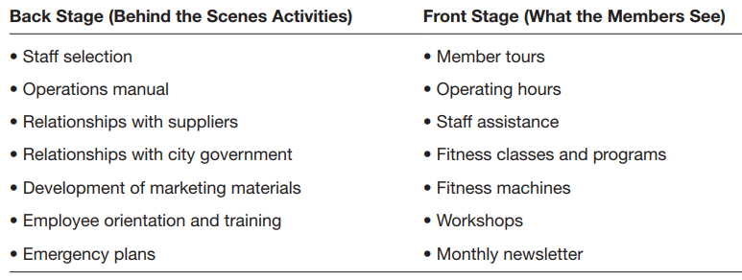
4-<number>

Slide 32
Section 7: Operations Plan
2 of 2
Key Insights
Your have to strike a careful balance
between adequately describing this
topic and providing too much
detail.
As a result, it is best to keep this
section short and crisp.
Operations Plan
4-<number>

Slide 33
Section 8: Product (or Service) Design and Development Plan
1 of 2
Product (or Service) Design and Development Plan
  If you’re developing a completely new product or service, you need to include a section that focuses on the status of your development efforts.
  Items to include in this section:
    Development status and tasks.
    Challenges and risks.
    Intellectual property.
4-<number>

Slide 34
Section 8: Product (or Service) Design and Development Plan
2 of 2
Key Insights
Many seemingly promising startups
never get off the ground because
their product development efforts
stall or turn out to be more difficult
than expected.
Its important to convince the reader
of your plan that this won’t happen
to you.
Product (or Service) Design and Development Plan
4-<number>

Slide 35
Section 9: Financial Projections
1 of 2
Financial Projections
  The final section of a business plan presents a firm’s pro forma (or projected) financial projections.
  Items to include in this section:
    Sources and uses of funds statement.
    Assumptions sheet.
    Pro forma income statements.
    Pro forma balance sheets.
    Pro forma cash flows.
    Ratio analysis.
4-<number>

Slide 36
Section 9: Financial Projections
2 of 2
Key Insights
Having completed the earlier
sections of the plan, its easy to see
why the financial projections come
last.
They take the plans you’ve
developed and express them in
financial terms.
Financial Projections
4-<number>

Slide 37
Appendix
  Any material that does not easily fit into the body of a business plan should appear in an appendix—résumés of the top management team, photos or diagrams of product or product prototypes, certain financial data, and market research projections.
  The appendix should not be bulky and add significant length to the business plan. It should include only the additional information vital to the plan but not appropriate for the body of the plan itself.
4-<number>

Slide 38
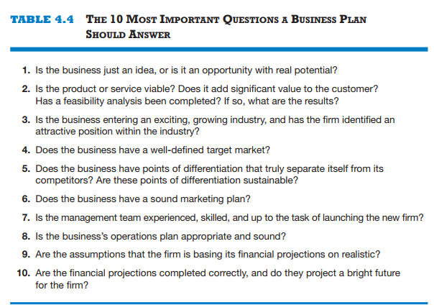
4-<number>

Slide 39
Presenting the Business Plan to Investors
1 of 3
The Oral Presentation
  The first rule in making an oral presentation is to follow instructions. If you’re told you have 15 minutes, don’t talk for more than the allotted time.
  The presentation should be smooth and well-rehearsed.
  The slides should be sharp and not cluttered.
Questions and Feedback to Expect from Investors
  The smart entrepreneur has a good idea of the questions that will be asked, and will be prepared for those queries.
4-<number>

Slide 40
Presenting the Business Plan to Investors
2 of 3
Twelve PowerPoint Slides to Include in an Investor Presentation
Title Slide
Problem
Solution
Opportunity and target market
Technology
Competition
7. Marketing and sales
8. Management team
9. Financial projections
10. Current status
11. Financing sought
12. Summary
4-<number>

Slide 41

Presenting the Business Plan to Investors
3 of 3
It’s also important to
look sharp when
presenting a business
plan.
This new venture team
is going over its
PowerPoint slides one
last time before an
investor presentation.
4-<number>

Slide 42
Different Terms:
Strategy
A business strategy is competitive moves and actions that a business uses to attract customers, compete successfully, strengthen performance, and achieve organizational goals.
Segmentation:
  Divide the market into different group of customers.
Target:
  Select the most attractive segment to focus your marketing on.
Positioning:
  Determine how to position your product for each target segment
4-<number>

